Slide 1

Moths!
Samuel Mashil
Notes:
Specifically helicoverpa moths

Slide 2
Background
Helicoverpa armigera is one of the world’s worst crop pests, and recently invaded South America.
Hybridised with Helicoverpa zea, spreading resistance genes
Difficult to distinguish – already a long genotyping process
Idea – create a machine learning model to distinguish species in the field using nothing but images of the moths’ wings
Notes:
Only getting harder as species hybridise further

Slide 3
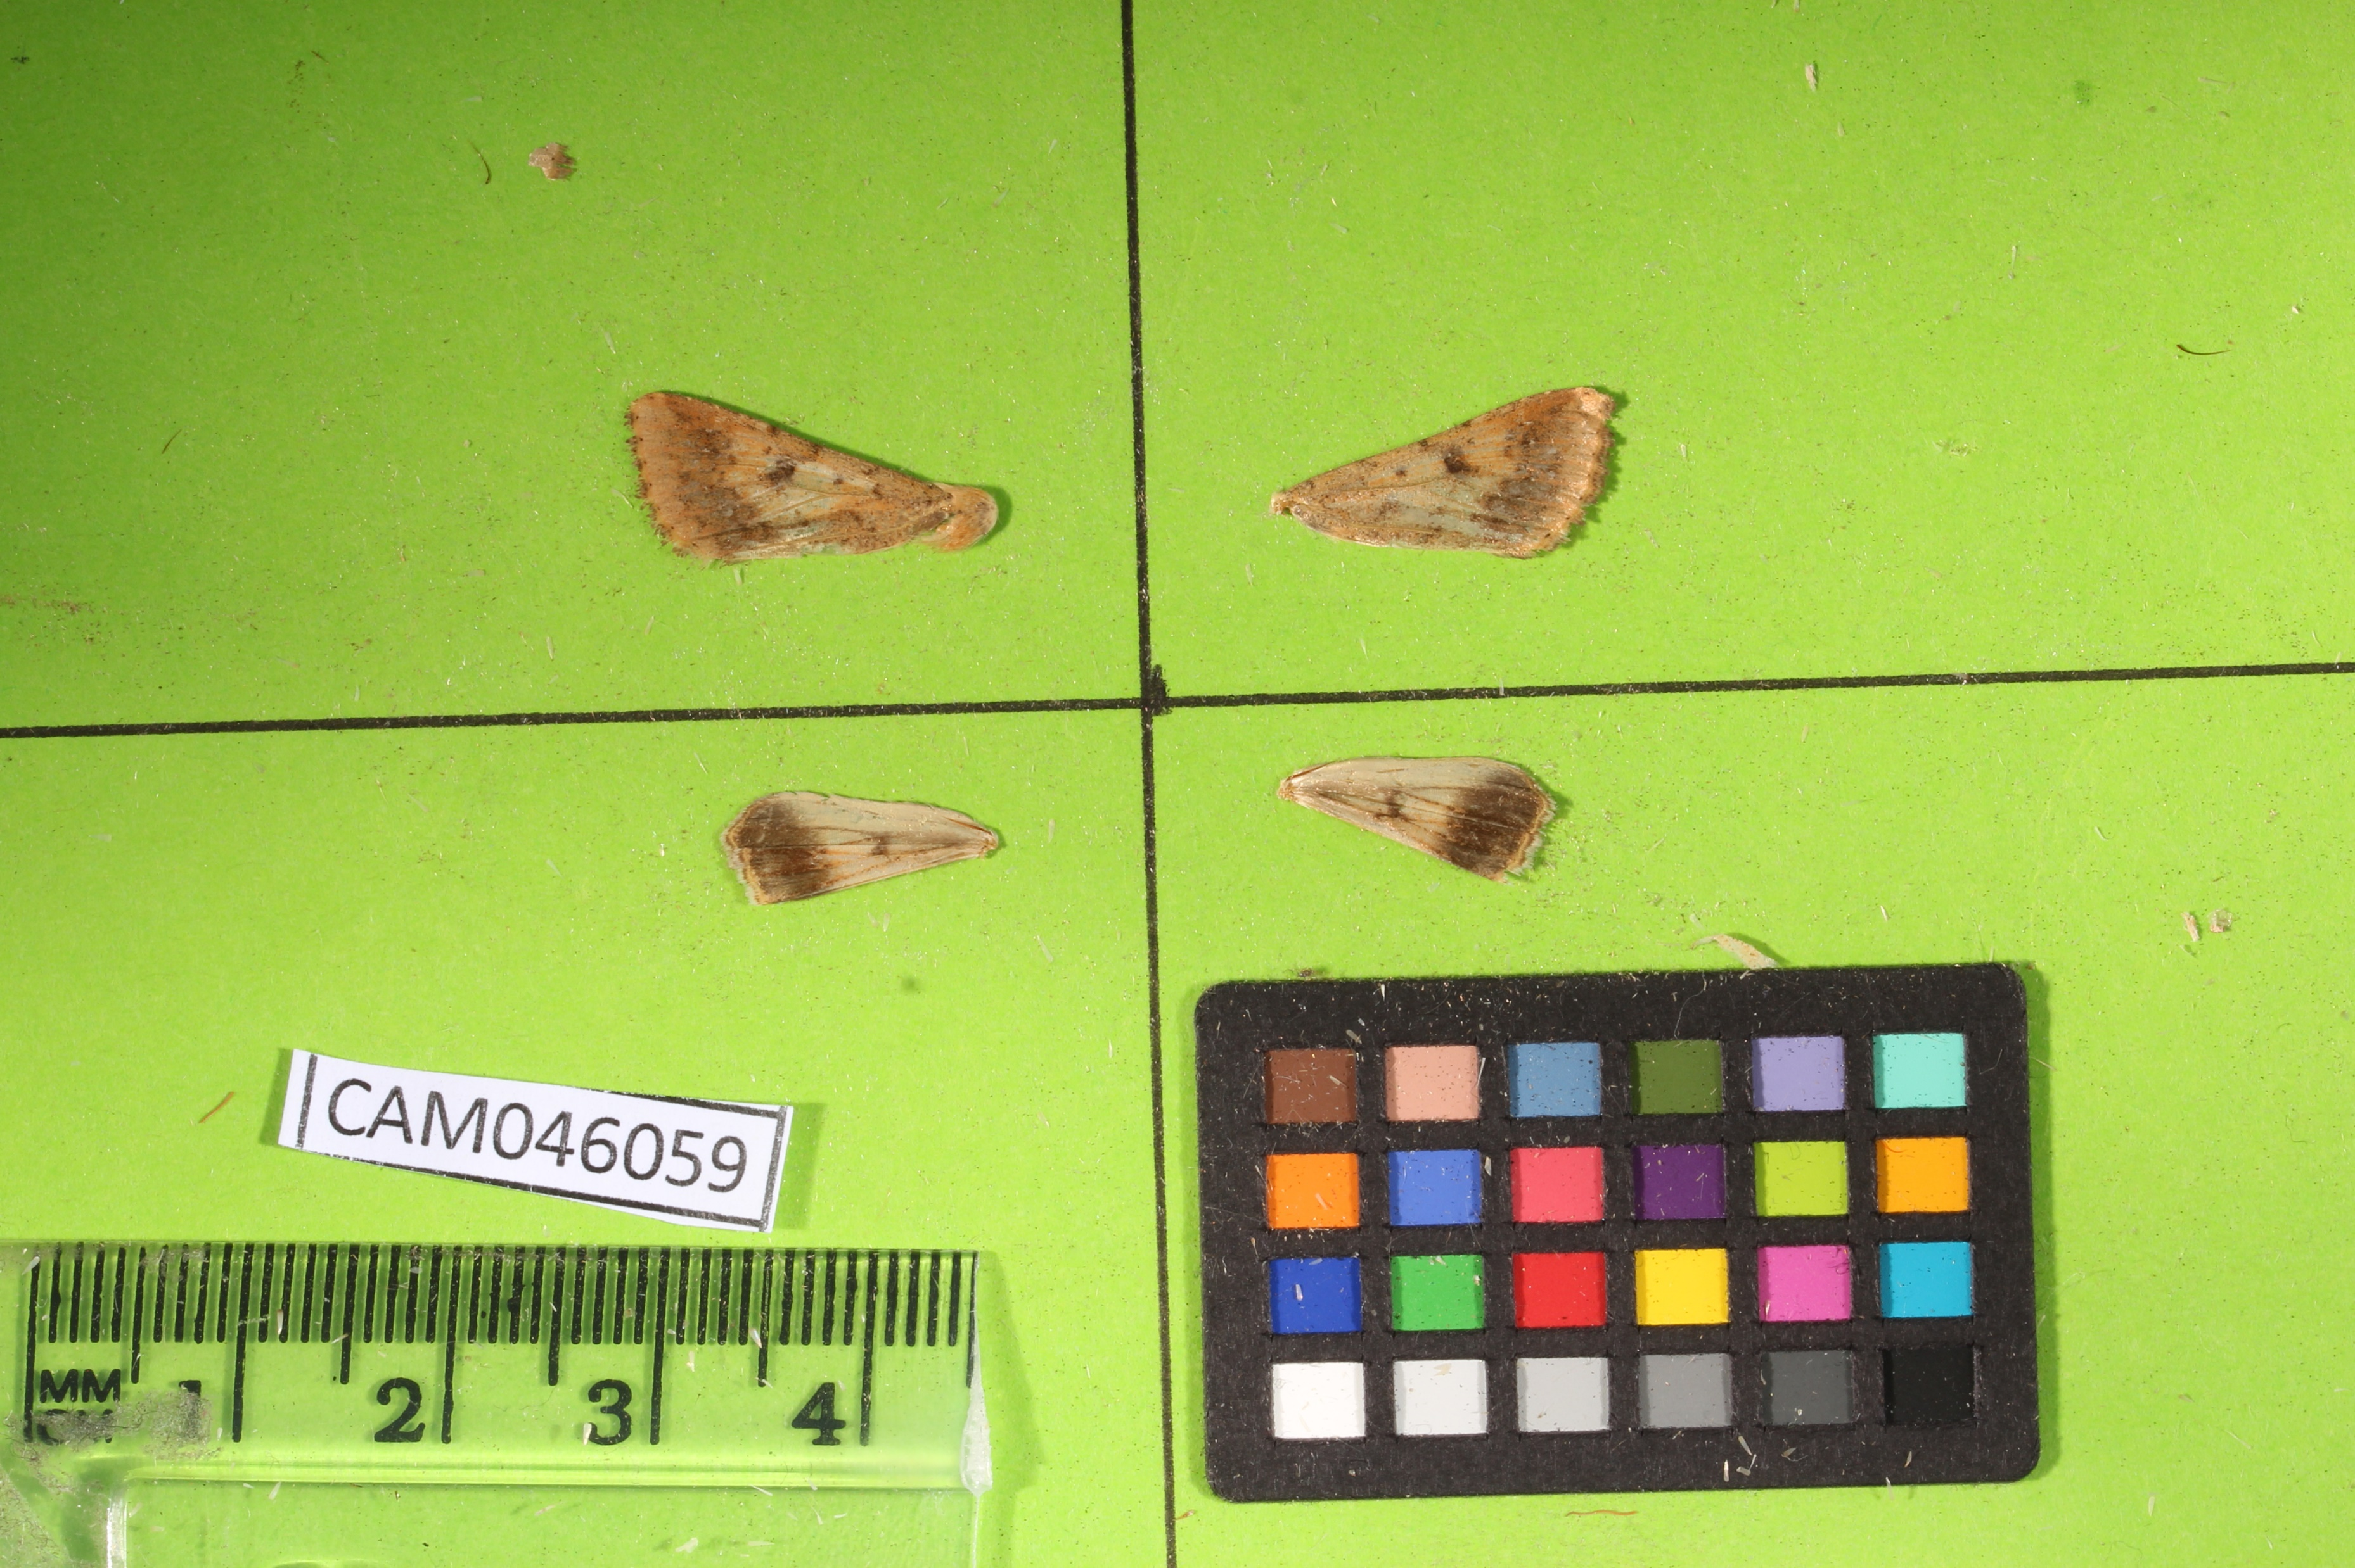
Notes:
Given bunch of images – messy part done for me
2 pictures for each individual – for each of ventral and dorsal sides of the wings

Slide 4

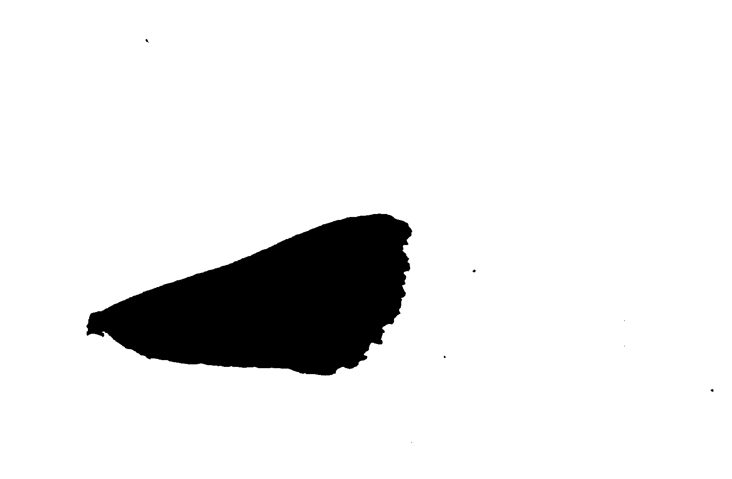
Notes:
Using program called ImageJ
Eventually switched this whole process to my favourite language, Python

Slide 5
Extracted Features
Area
Major/minor axes lengths
Circularity
Feret and minimum feret
Aspect Ratio
Shape
Colours
Notes:
Not going to show boring programming code

Slide 6

Simple Algorithms
Logistic Regression
Linear Discriminant Analysis (LDA)

Slide 7

Simple Algorithms
Logistic Regression
$$p=\frac{1}{1+e^{−\left(a_{0}+a_{1}X_{1}+a_{2}X_{2}+…\right)}}$$
Linear Discriminant Analysis (LDA)

Slide 8
Findings
LDA works best
Logistic Regression: 76.94% ± 2.92
LDA: 77.82% ± 1.37
Notes:
Explain why accuracy changes - cannot use data that the models been trained on to measure accuracy
Proof of concept worked

Slide 9
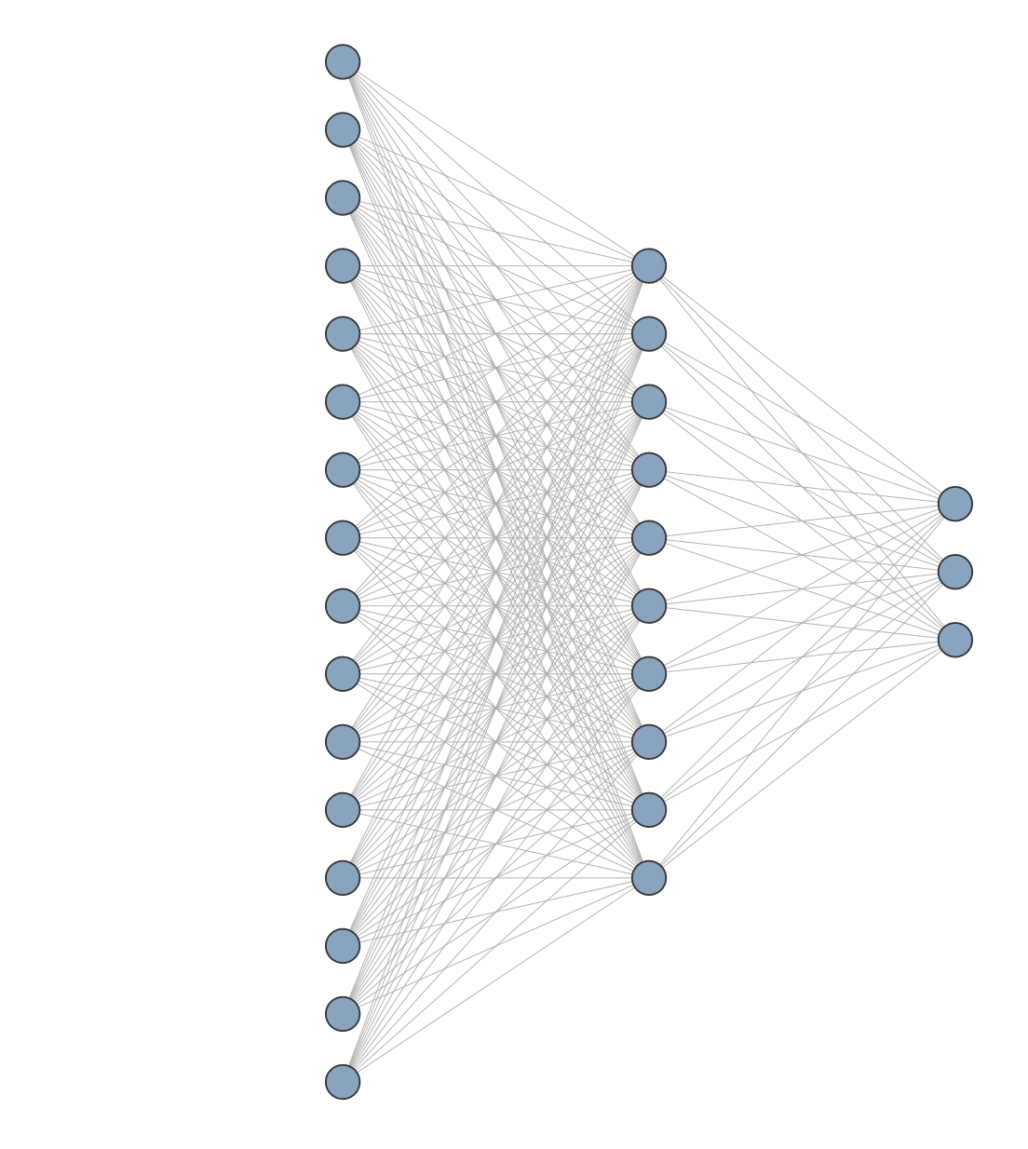
Moving onto neural networks
Initially using the same previously-determined extracted features
Best architecture seemed to be a single hidden layer with 10 nodes
Accuracy: 76.43% ± 2.31
Notes:
Neural network – effectively same process as LR of taking weighted sum, but at every single node
3 output nodes – for arm, hyb, zea
For given set of inputs,
Looked promising
not far off LDA and LR - few optimisations could be made
but also wished to try image-based as well

Slide 10
Image-based neural network
Not so good
Average Accuracy: 71.898% ± 2.146
Pretrained model (VGG16)
Accuracy: 72.606%
Clearly less accurate than using the extracted features
Notes:
Pretrained model – already trained on millions of images from the internet – can then be finetuned for specific use-case

Slide 11

Refining the network
Learning rate scheduler
Early stopping
Batch normalisation
Different architectures
Learning rate scheduler
Early stopping
Dropout
Regularization
Batch normalisation
Different architectures
Gradient clipping
Early stopping
Batch normalisation
Dropout
Regularization
Different architectures
Gradient clipping
Notes:
Tried many different optimisations (took weeks) – ones that made big difference listed here
Normalisation – training data only
Learning rate scheduler helped refinement at end
LRS – adjusting how quickly weights are adjusted: lower takes longer to train but more likely to find an optimal solution
Early stopping rather than training for set number of iterations – stops adjusting weights once changes being made that are specific to training subset, and don’t carry across to the testing set – overfitting

Slide 12
Refining the network
Learning rate scheduler
Early stopping
Batch normalisation
Different architectures
Accuracy: 80.502% ± 2.051
Learning rate scheduler
Early stopping
Dropout
Regularization
Batch normalisation
Different architectures
Gradient clipping
Early stopping
Batch normalisation
Dropout
Regularization
Different architectures
Gradient clipping
Notes:
Normalisation – training data only
Learning rate scheduler helped refinement at end

Slide 13
Notes:
Removed lines for models w/o hybrids
Close LDA makes sense as assumption of normal distribution was valid

Slide 14
Most relevant features
Colour – specifically ventral (front side) colour
More green and blue suggests zea
More red suggests armigera
Feret and minimum feret diameters
Higher feret diameter suggests zea
Higher minimum feret diameter suggests armigera
Area
Larger area suggests zea
Notes:
Using model to go backwards and find best features
Not putting all numbers here because too many numbers already - hurts my brain
Using LDA model – NN hard to make sense of
Colours on dorsal side – interestingly more green for zea, more blue for arm
Feret, area, etc – same across ventral and dorsal side unsurprisingly
But differs between wings
Front wings – area and feret were by far most important
Rear wings – colour made biggest difference
Differences between wings brought to light issue of pseudoreplication

Slide 15
Class Imbalance Over 72% armigera!
Notes:
72.56479% of data is arm – makes 80% accuracy less impressive

Slide 16

Baselines
Zero Weight Baseline – always predicting the majority class
$72.6\%$ accuracy
Random Rate Baseline – guessing randomly, but weighted according to class balance
${0.7256}^{2}+{0.1403}^{2}+{0.1340}^{2} = 0.56421897822≈56.4\%$
Notes:
In theory, NN is doing better than both baselines, so it’s definitely doing something at least, but better way to tell is to manually balance classes

Slide 17
Balancing the Classes
Over-sampling or under-sampling: both give similar results
Accuracy: 65.31% ± 6.91
Baseline in this case would be around 33%, so performance is much better.
Notes:
80% accuracy from before was not just due to class imbalance, and can be trusted
Baseline can be measured in multiple different ways (zero-weight, random-rate), but around 33% regardless.
All this shows accuracy isn’t the best/most representative measurement
This was final step required in proving that the machine learning model was in fact working as intended

Slide 18
Conclusions
Machine learning works!
Whilst not perfect, the final model still performs its role as an aid to farmers in the field
Could be improved with more data or further refinement
Future ideas:
Explore models deeper – how each feature individually affects each models
How these effects differ across wings/samples
Finetuning models accordingly to better fit each wing specifically
Notes:
Works specifically thanks to most relevant features
Refer to original goal of detecting species using just wings
Makes farmers lives easier
Future ideas (if I had more time)
Effects of individual features could be used to finetune models further thanks to better understanding
On that note, I don’t have more time, so thank you all for the opportunity to take part in this programme, to Api and Gabby specifically, and to all of you for listening.

